Slide 1
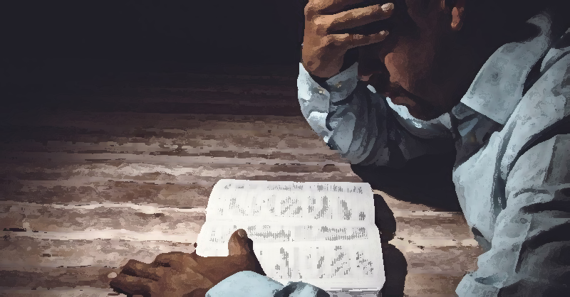
FLIP THE SCRIPT
What it really means
to be a man

Slide 2

SESSION ONE
WHAT IS THE SCRIPT?
Comparing worldly models of manhood with God’s good design

Slide 3
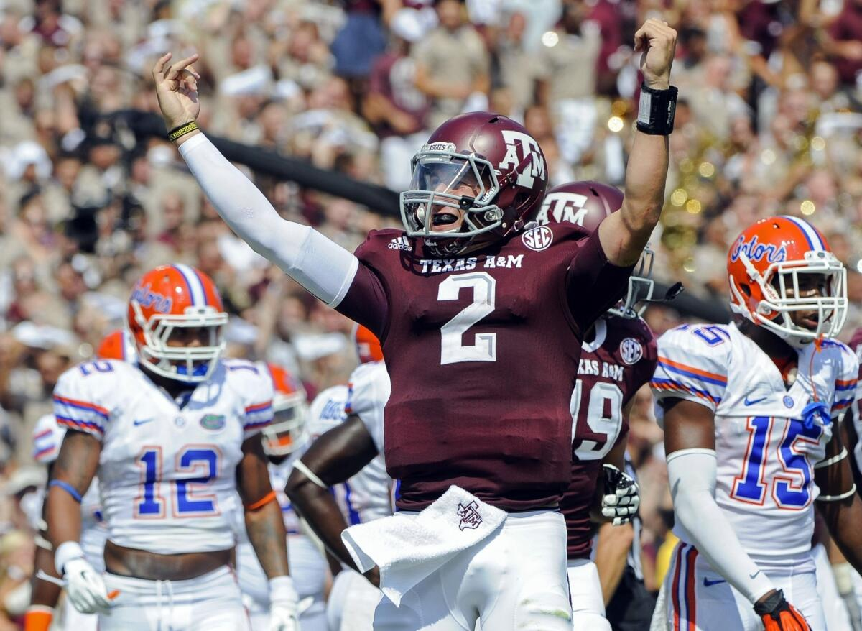


Slide 4
Evangelicals could articulate a social script for our moment… In the absence of a meaningful script for our lives, men are in crisis… it should be no surprise that men starved for a constructive vision of masculinity would come to despair… Our culture is flinching away from this question. The church must not.
Cosper, “How Then Should Men Live,” CT

Slide 5
“Progressives refuse to accept that important gender inequalities can run in both directions, and they quickly label male problems as symptoms of ‘toxic masculinity.’ Conservatives appear more sensitive to the struggles of boys and men but only as a justification for turning back the clock and restoring traditional gender roles… What is needed is a positive vision of masculinity that is compatible with gender equality.”
Reeves, Of Boys and Men, xiv

Slide 6
MAN UP AND TALK ABOUT IT!
3 minutes with the guys next to you…
1. Are men in trouble in our day? How so?
2. What “pressure points” did you feel personally as we talked about the “need for a script” for men?

Slide 7
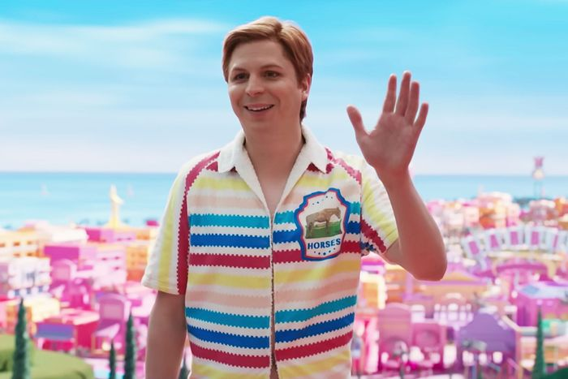
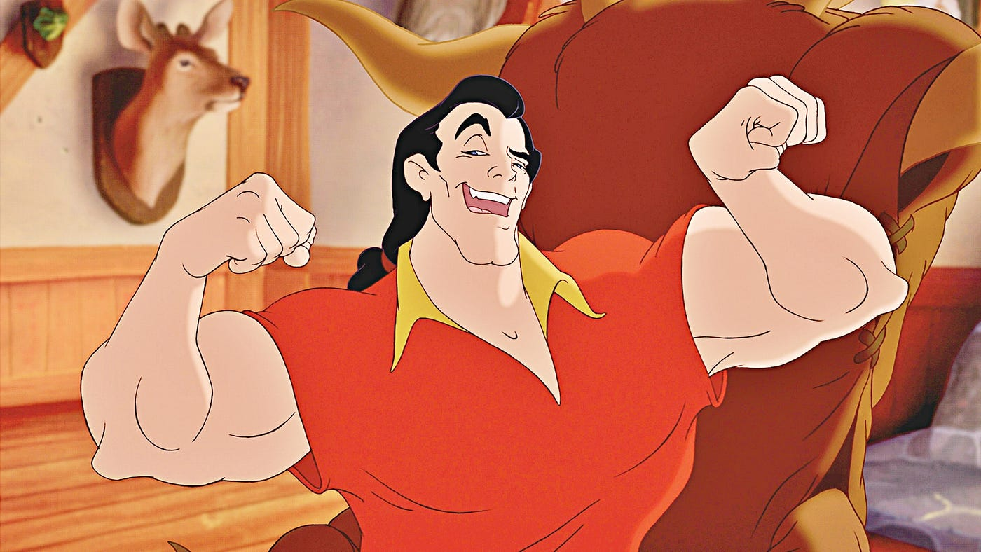

Slide 8
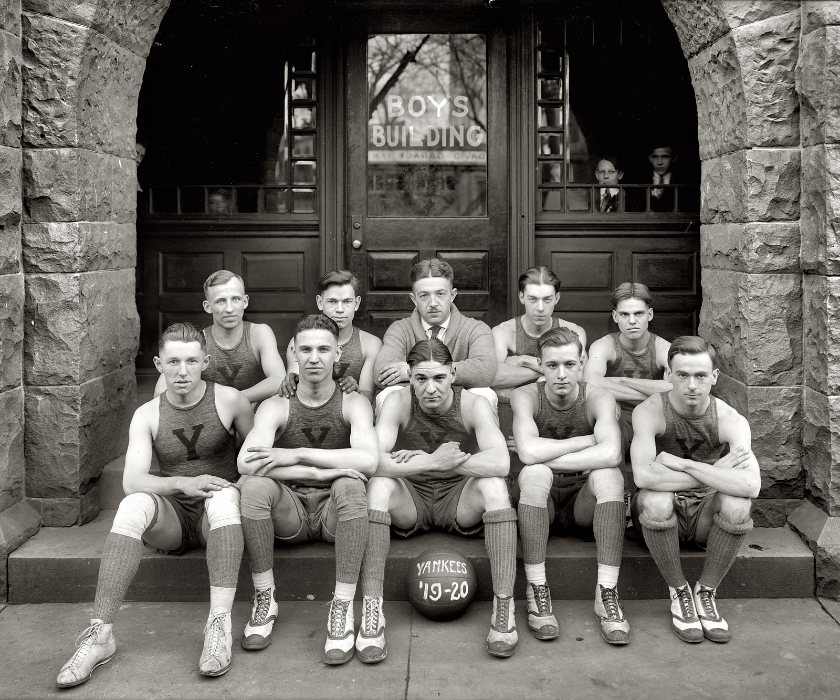
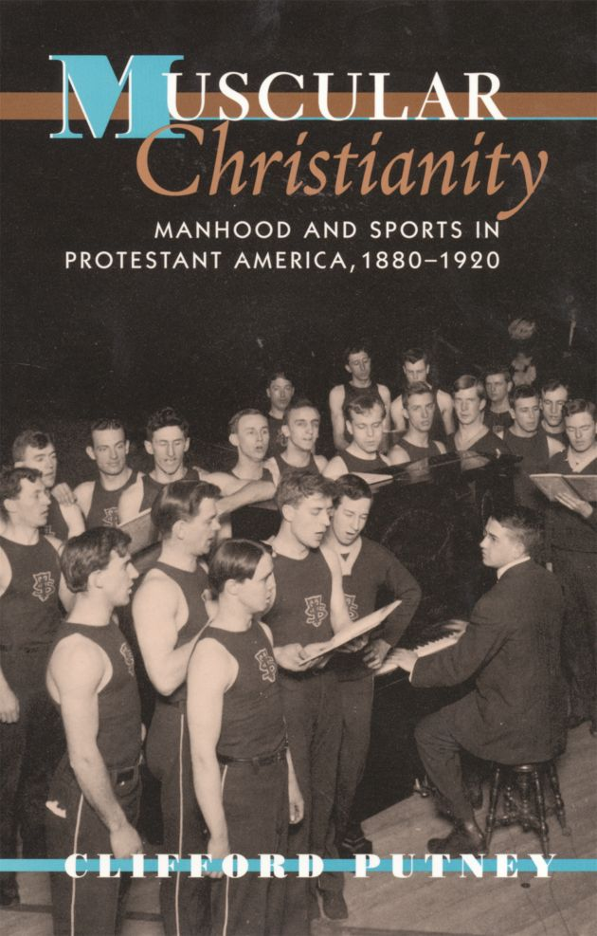

Slide 9
MAN UP AND PRAY ABOUT IT!
3 minutes with the guys next to you…
Pray for God to open our hearts to his word –
that we will become the men Jesus showed us to be, women pray we can be, families long for us to be, and God calls us to be.

Slide 10
So God created mankind in his own image, in the image of God he created them, male and female he created them. God blessed them and said to them, “Be fruitful and increase in number; fill the earth and subdue it.”
Genesis 1:27-28
The Lord God took the man and put him in the Garden of Eden to work it and take care of it.
Genesis 2:15
The Lord God said, “It is not good for man to be alone. I will make a helper suitable for him.”
Genesis 2:18
Grounded in God’s Creative Design

Slide 11
He is the one we proclaim, admonishing and teaching everyone with all wisdom, so that we may present everyone fully mature in Christ.
Colossians 1:28
We have seen his glory, the glory of the One and Only Son, who came from the Father, full of grace and truth.
John 1:14
For even the Son of Man did not come to be served, but to serve, and to give his life as a ransom for many.
Mark 10:45
Bound by Conformity to Christ

Slide 12
Love the Lord your God with all your heart and with all your soul and with all your mind… Love your neighbor as yourself.
Matthew 22:37-39
The fruit of the Spirit is love, joy, peace, patience, kindness, goodness, faithfulness, gentleness, and self-control.
Galatians 5:22
Go and make disciples of all nations…
Matthew 28:19
Built Upon Essential Christian Calling

Slide 13
For you know that we dealt with each of you as a father deals with his own children, encouraging, comforting, and urging you to live lives worthy of God.
1 Thessalonians 2:12
Teach the older men to be temperate, worthy of respect, self-controlled, and sound in faith, in love and in endurance… Encourage the youth men to be self-controlled.
Titus 2:2, 6
Husbands, love your wives as Christ loved the church…
Ephesians 5:25
Shaped by Specific Instruction and Warning to Men

Slide 14
Biblical Masculinity
A suggested definition
Men using their God-given strength to make the world and people better and safer, and providing loving, sacrificial leadership in God-ordained roles.

Slide 15
MAN UP AND TALK ABOUT IT!
3 minutes with the guys next to you…
1. Who or what do you need to better work or cultivate?
2. Who are what do you need to better keep or protect?

Slide 16
SESSION TWO
WHEN HEADSHIP GOES TO YOUR HEAD
Learning to lead like Jesus, from the bottom up

Slide 17
MAN UP AND THINK ABOUT IT!
2 minutes to yourself…
Are your relationships flourishing or fighting?

Slide 18
MAN UP AND THINK ABOUT IT!
2 minutes to yourself…
Have you placed your trust in Jesus alone for salvation?
Do you need to confess any sin to Jesus right now?

Slide 19
SESSION THREE
TOOLS OF THE TRADE
Exchanging rusty saws that make a mess for “power tools” that really bless

Slide 20



You are more than enough.
I am delighted by you.
I accept you.
You are not good enough.
I am disappointed by you.
I reject you.

Slide 21
SESSION FOUR
DITCH THE SCRIPT
Downloading a better version of sexual intimacy

Slide 22
SESSION FIVE
BECOMING SONS OF BOAZ
Building a life and legacy of true strength

